Slide 1
CSE 2215: Data Structure and Algorithms-I
Complexity Analysis & Asymptotic Notation

Slide 2
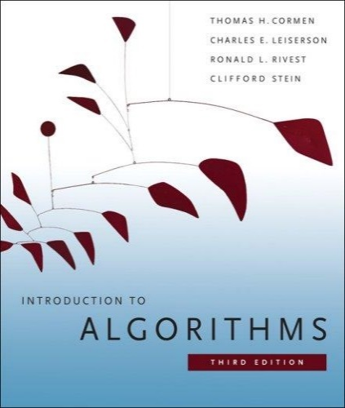
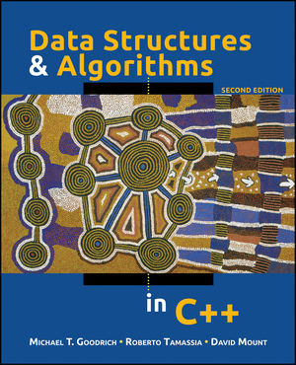
The Course
Text Books
Introduction to Algorithms (Third edition)
Cormen, Leiserson, Rivest, and Stein
An excellent reference you should own
Data Structures and Algorithms in C++
Goodrich, Tamassia, and Mount

Slide 3
Contents
Introduction to Data Structures
Introduction to Algorithms
Analysis of Algorithms

Slide 4
INTRODUCTION TO DATA STRUCTURES

Slide 5
What is a Data Structure?
Data is a collection of facts, such as values, numbers, words, measurements, or observations.
Structure means a set of rules that holds the data together.
A data structure is a particular way of storing and organizing data in a computer so that it can be used efficiently.
Different kinds of data structures are suited to different kinds of applications, and some are highly specialized to specific tasks.
Data structures provide a means to manage huge amount of data efficiently.

Slide 6
Types of Data Structures
Data structures are classified as either
Linear (e.g, arrays, linked lists), or
Nonlinear (e.g, trees, graphs, etc.)
A data structure is said to be linear if it satisfies the following four conditions
There is a unique element called the first
There is a unique element called the last
Every element, except the last, has a unique successor
Every element, except the first, has a unique predecessor
There are two ways of representing a linear data structure in memory
By means of sequential memory locations (arrays)
By means of pointers or links (linked lists)

Slide 7
INTRODUCTION TO ALGORITHMS

Slide 8
What is an Algorithm?
An algorithm is a sequence of computational steps that transform the input into the output.
An algorithm is a tool for solving a well-specified computational problem.
An algorithm is said to be correct if, for every input instance, it halts with the correct output
An incorrect algorithm might not halt at all on some input instances, or it might halt with other than the desired output.
Note that algorithms existed way before the invention of computers

Slide 9

What is a Program?
A program is the expression of an algorithm in a programming language
A set of instructions which the computer will follow to solve a problem

Slide 10
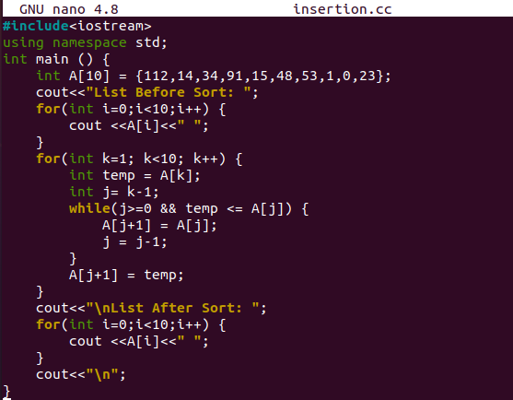
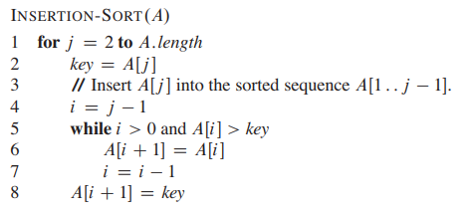
Algorithm vs Program

Slide 11
The Big Picture
Problem:
Input is a sequence of integers stored in an array.
Output the minimum.
INPUT
Algorithm
OUTPUT
m:= a[1];
for I:=2 to size of input
if m > a[i] then
m:=a[I];
return s
a[]:
25, 90, 53, 23, 11, 34
11
m, a[i]
Data-Structure

Slide 12
ANALYSIS OF ALGORITHM

Slide 13
Necessity of Analysis of Algorithms
Need to recognize limitations of various algorithms for solving a problem
Need to understand relationship between problem size and running time
Need to learn how to analyze an algorithm's running time without coding it
Need to recognize bottlenecks in code as well as which parts of code are easiest to optimize
Need to learn techniques for writing more efficient code

Slide 14
What do we Analyze in an algorithm?
Correctness
Does the input/output relation match algorithm requirement?
Amount of work done (complexity)
Basic operations to do task
Amount of space used
Memory used
Simplicity, clarity
Verification and implementation.
Optimality
Is it impossible to do better?

Slide 15
Analysis Based on Input Size
Time and space complexity
This is generally a function of the input size
e.g., sorting, multiplication
How we characterize input size depends
Sorting: number of input elements
Graph algorithms: number of nodes & edges
Etc.

Slide 16

Insertion Sort
WHERE IS THE ALGORITHM?

Slide 17
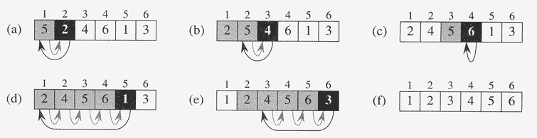
An Example: Insertion Sort
A = {5, 2, 4, 6, 1, 3}

Slide 18
Analyzing Insertion Sort
5
2
4
6
1
3
i=2

Slide 19
Analyzing Insertion Sort
5
4
6
1
3
i=2
2

Slide 20
Analyzing Insertion Sort
5
4
6
1
3
i=2
2
Key

Slide 21
Analyzing Insertion Sort
5
4
6
1
3
i=2
2
Key

Slide 22
Analyzing Insertion Sort
5
4
6
1
3
i=2
2
Key

Slide 23
Analyzing Insertion Sort
2
5
4
6
1
3
i=2

Slide 24
Analyzing Insertion Sort
2
5
4
6
1
3
i=3

Slide 25
Analyzing Insertion Sort
2
5
6
1
3
i=3
4
Key

Slide 26
Analyzing Insertion Sort
2
5
6
1
3
i=3
4
Key

Slide 27
Analyzing Insertion Sort
2
5
6
1
3
i=3
4
Key

Slide 28
Analyzing Insertion Sort
2
4
5
6
1
3
i=3

Slide 29
Analyzing Insertion Sort
2
4
5
6
1
3
i=4

Slide 30
Analyzing Insertion Sort
2
4
5
1
3
i=4
6
Key

Slide 31
Analyzing Insertion Sort
2
4
5
6
1
3
i=4

Slide 32
Analyzing Insertion Sort
2
4
5
6
3
i=5
1
Key

Slide 33
Analyzing Insertion Sort
2
4
5
6
3
i=5
1
Key

Slide 34
Analyzing Insertion Sort
2
4
5
6
3
i=5
1
Key

Slide 35
Analyzing Insertion Sort
2
4
5
6
3
i=5
1
Key

Slide 36
Analyzing Insertion Sort
2
4
5
6
3
i=5
1
Key

Slide 37
Analyzing Insertion Sort
2
4
5
6
3
i=5
1
Key

Slide 38
Analyzing Insertion Sort
2
4
5
6
3
i=5
1
Key

Slide 39
Analyzing Insertion Sort
2
4
5
6
3
i=5
1
Key

Slide 40
Analyzing Insertion Sort
2
4
5
6
3
i=5
1
Key

Slide 41
Analyzing Insertion Sort
1
2
4
5
6
3
i=5

Slide 42
Analyzing Insertion Sort
1
2
4
5
6
3
i=6

Slide 43
Analyzing Insertion Sort
1
2
4
5
6
i=6
3
Key

Slide 44
Analyzing Insertion Sort
1
2
4
5
6
i=6
3
Key

Slide 45
Analyzing Insertion Sort
1
2
4
5
6
i=6
3
Key

Slide 46
Analyzing Insertion Sort
1
2
4
5
6
i=6
3
Key

Slide 47
Analyzing Insertion Sort
1
2
4
5
6
i=6
3
Key

Slide 48
Analyzing Insertion Sort
1
2
4
5
6
i=6
3
Key

Slide 49
Analyzing Insertion Sort
1
2
4
5
6
i=6
3
Key

Slide 50
Analyzing Insertion Sort
1
2
4
5
6
i=6
3
Key

Slide 51
Analyzing Insertion Sort
1
2
3
4
5
6
i=6

Slide 52
Analyzing Insertion Sort
Now let us try to write the Algorithm (in pseudocode format)

Slide 53
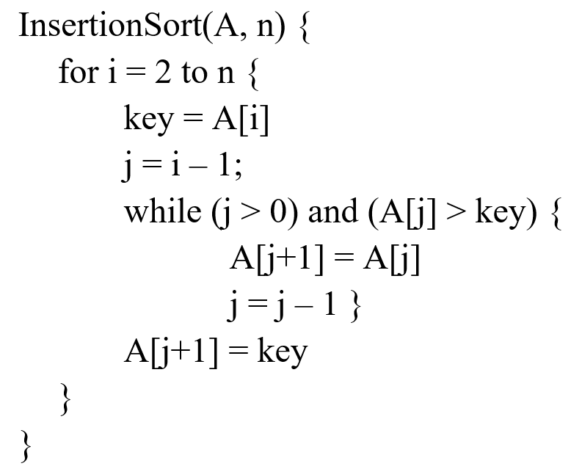
Analyzing Insertion Sort
Now let us try to write the Algorithm (in pseudocode format)

Slide 54
Analyzing Insertion Sort
5
2
4
6
1
3
i=2

Slide 55
Analyzing Insertion Sort
5
4
6
1
3
i=2
2

Slide 56
Analyzing Insertion Sort
5
4
6
1
3
i=2
2
Key

Slide 57
Analyzing Insertion Sort
5
4
6
1
3
i=2
2
Key

Slide 58
Analyzing Insertion Sort
5
4
6
1
3
i=2
2
Key

Slide 59
Analyzing Insertion Sort
5
4
6
1
3
i=2
2
Key

Slide 60
Analyzing Insertion Sort
5
4
6
1
3
i=2
2
Key

Slide 61
Analyzing Insertion Sort
5
4
6
1
3
i=2
2
Key

Slide 62
Analyzing Insertion Sort
2
5
4
6
1
3
i=2

Slide 63
Analyzing Insertion Sort
2
5
4
6
1
3
i=3

Slide 64
Analyzing Insertion Sort
2
5
6
1
3
i=3
4
Key

Slide 65
Analyzing Insertion Sort
2
5
6
1
3
i=3
4
Key

Slide 66
Analyzing Insertion Sort
2
5
6
1
3
i=3
4
Key

Slide 67
Analyzing Insertion Sort
2
5
6
1
3
i=3
4
Key

Slide 68
Analyzing Insertion Sort
2
5
6
1
3
i=3
4
Key

Slide 69
Analyzing Insertion Sort
2
5
6
1
3
i=3
4
Key

Slide 70
Analyzing Insertion Sort
2
4
5
6
1
3
i=3

Slide 71
Analyzing Insertion Sort
2
4
5
6
1
3
i=4

Slide 72
Analyzing Insertion Sort
2
4
5
1
3
i=4
6
Key

Slide 73
Analyzing Insertion Sort
2
4
5
1
3
i=4
6
Key

Slide 74
Analyzing Insertion Sort
2
4
5
1
3
i=4
6
Key

Slide 75
Analyzing Insertion Sort
2
4
5
6
1
3
i=4

Slide 76
Analyzing Insertion Sort
2
4
5
6
3
i=5
1
Key

Slide 77
Analyzing Insertion Sort
2
4
5
6
3
i=5
1
Key

Slide 78
Analyzing Insertion Sort
2
4
5
6
3
i=5
1
Key

Slide 79
Analyzing Insertion Sort
2
4
5
6
3
i=5
1
Key

Slide 80
Analyzing Insertion Sort
2
4
5
6
3
i=5
1
Key

Slide 81
Analyzing Insertion Sort
2
4
5
6
3
i=5
1
Key

Slide 82
Analyzing Insertion Sort
2
4
5
6
3
i=5
1
Key

Slide 83
Analyzing Insertion Sort
2
4
5
6
3
i=5
1
Key

Slide 84
Analyzing Insertion Sort
2
4
5
6
3
i=5
1
Key

Slide 85
Analyzing Insertion Sort
2
4
5
6
3
i=5
1
Key

Slide 86
Analyzing Insertion Sort
2
4
5
6
3
i=5
1
Key

Slide 87
Analyzing Insertion Sort
2
4
5
6
3
i=5
1
Key

Slide 88
Analyzing Insertion Sort
2
4
5
6
3
i=5
1
Key

Slide 89
Analyzing Insertion Sort
1
2
4
5
6
3
i=5

Slide 90
Analyzing Insertion Sort
1
2
4
5
6
3
i=6

Slide 91
Analyzing Insertion Sort
DO IT YOURSELF!!
1
2
4
5
6
i=6
3
Key

Slide 92
Analyzing Insertion Sort
DO IT YOURSELF!!
1
2
4
5
6
i=6
3
Key

Slide 93
Analyzing Insertion Sort
DO IT YOURSELF!!
1
2
4
5
6
i=6
3
Key

Slide 94
Analyzing Insertion Sort
DO IT YOURSELF!!
1
2
4
5
6
i=6
3
Key

Slide 95
Analyzing Insertion Sort
DO IT YOURSELF!!
1
2
4
5
6
i=6
3
Key

Slide 96
Analyzing Insertion Sort
DO IT YOURSELF!!
1
2
4
5
6
i=6
3
Key

Slide 97
Analyzing Insertion Sort
DO IT YOURSELF!!
1
2
4
5
6
i=6
3
Key

Slide 98
Analyzing Insertion Sort
DO IT YOURSELF!!
1
2
4
5
6
i=6
3
Key

Slide 99
Analyzing Insertion Sort
DO IT YOURSELF!!
1
2
4
5
6
i=6
3
Key

Slide 100
Analyzing Insertion Sort
DO IT YOURSELF!!
1
2
4
5
6
i=6
3
Key

Slide 101
Analyzing Insertion Sort
DO IT YOURSELF!!
1
2
4
5
6
i=6
3
Key

Slide 102
Analyzing Insertion Sort
DO IT YOURSELF!!
1
2
4
5
6
i=6
3
Key

Slide 103
Analyzing Insertion Sort
DO IT YOURSELF!!
1
2
3
4
5
6
i=6

Slide 104
Analyzing Insertion Sort
DO IT YOURSELF!!
1
2
3
4
5
6
i=6

Slide 105
Analyzing Insertion Sort
DO IT YOURSELF!!
1
2
3
4
5
6
i=6
NOTE: This loop will run n (6) times

Slide 106
Analyzing Insertion Sort
DO IT YOURSELF!!
1
2
3
4
5
6
i=6
NOTE: This loop will run n (6) times

Slide 107
Analyzing Insertion Sort
DO IT YOURSELF!!
1
2
3
4
5
6
i=6
NOTE: This loop will run n (6) times
For 5 times - the condition will be true
For 1 time - the condition will be false

Slide 108
Analyzing Insertion Sort
Keep in mind
Each line (statement) in a code takes some time to run.
It will be different for different PCs
Let us call this time required to execute a statement : cost
Let us analyze the total time required for insertion sort

Slide 109
Analyzing Insertion Sort
Let us try to write the pseudocode by ourselves and determine the total time

Slide 110
Analyzing Insertion Sort
Statement Cost Times
InsertionSort(A, n) {
for i = 2 to n { c₁ n
key = A[i] c₂ (n – 1)
j = i – 1; c₃ (n – 1)
while (j > 0) and (A[j] > key) { c₄ T
A[j+1] = A[j] c₅ (T – (n – 1))
j = j – 1 } c₆ (T – (n – 1))
A[j+1] = key c₇ (n – 1)
}
}
T = t₂ + t₃ + … + t_{n}, where t_{i} is the number of while expression evaluations for the i^{th} for loop iteration

Slide 111
Analyzing Insertion Sort
T(n) = c₁n + c₂(n-1) + c₃(n-1) + c₄T + c₅(T - (n-1)) + c₆(T - (n-1)) + c₇(n-1) = c₈T + c₉n + c₁₀

Slide 112
Analyzing Insertion Sort
T(n) = c₁n + c₂(n-1) + c₃(n-1) + c₄T + c₅(T - (n-1)) + c₆(T - (n-1)) + c₇(n-1) = c₈T + c₉n + c₁₀
We can understand that
The time will be more if the number of input elements is more
We can also understand that the time will be more if the while loop runs more

Slide 113
Analyzing Insertion Sort
T(n) = c₈T + c₉n + c₁₀
We can also understand that the time will be more if the while loop runs more
What can T be?
Best case: the array is sorted (inner loop body never executed)
t_{i} = 1 🡺 T = n-1
T(n) = an + b, a linear function of n
Worst case: the array is reverse sorted (inner loop body executed for all previous elements)
t_{i} = i 🡺 T = n(n + 1)/2 - 1
T(n) = an² + bn + c, a quadratic function of n
Average case:
Will still be n² as there is no guarantee how much checking we have to do on a random array. We might have to check 1 or (n-1) for each case

Slide 114
Best Case
Best Case — Ω(n)
When does it happen?
The array is already sorted.
What happens?
For each element, we only check once and see it is already in the right place.
No shifting.
Why Ω(n)?
We do 1 comparison for each of the n elements → n steps.

Slide 115
Worst Case
Worst Case — O(n²)
When does it happen?
The array is reverse sorted
What happens?
Every new element has to move all the way to the front.
Lots of comparisons + lots of shifting
Why O(n²)?
1st element → 1 comparison
2nd element → 2 comparisons
3rd element → 3 comparisons
(n−1)th element → (n−1) comparisons
1+2+⋯+(n−1)= {n(n-1)/2​} ∼ O(n²)

Slide 116
Average Case
Average Case — Θ(n²)
When does it happen?
The array is in a random order.
What happens?
On average, each element moves halfway back in the sorted portion.
So each step takes about i/2 comparisons.
Why Θ(n²)?
Total work ∼ ½(1+2+3+.....+(n-1)) which is proportional to Θ(n²)

Slide 117
ASYMPTOTIC ANALYSIS

Slide 118
Asymptotic Analysis
Upper Bound
Provides an upper bound on running time
An absolute guarantee
Asymptotically Tight
Provides the expected running time
Very useful, but treat with care: what is “average”?
Random (equally likely) inputs
Real-life inputs
Lower Bound

Slide 119
Upper Bound Notation
We say InsertionSort’s run time is O(n²)
Properly we should say run time is in O(n²)
Read O as “Big-O” (you’ll also hear it as “order”)
In general a function
f(n) is O(g(n)) if there exist positive constants c and n₀ such that 0 ≤ f(n) ≤ c ⋅ g(n) for all n ≥ n₀
Formally
O(g(n)) = { f(n): ∃ positive constants c and n₀ such that 0 ≤ f(n) ≤ c ⋅ g(n) ∀ n ≥ n₀ }

Slide 120
Upper Bound Notation
c.g(n)
time
f(n)
n₀
n
We say g(n) is an asymptotic upper bound for f(n)

Slide 121
Lower Bound Notation
We say InsertionSort’s run time is Ω(n)
In general a function
f(n) is Ω(g(n)) if ∃ positive constants c and n₀ such that 0 ≤ c⋅g(n) ≤ f(n) ∀ n ≥ n₀
Proof:
Suppose run time is an + b
Assume a and b are positive
an ≤ an + b

Slide 122
Lower Bound Notation
f(n)
time
c.g(n)
n₀

Slide 123
Asymptotic Tight Bound Notation
A function f(n) is Θ(g(n)) if ∃ positive constants c₁, c₂, and n₀ such that 0 ≤ c₁ g(n) ≤ f(n) ≤ c₂ g(n) ∀ n ≥ n₀
Theorem
f(n) is Θ(g(n)) iff f(n) is both O(g(n)) and Ω(g(n))
Proof:

Slide 124
Asymptotic Tight Bound Notation
c₂.g(n)
f(n)
time
c₁.g(n)
n₀
n

Slide 125
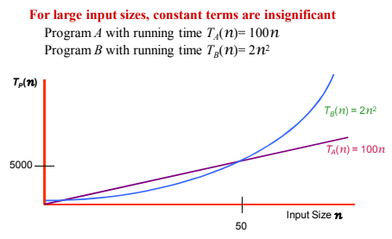
Practical Complexity

Slide 126
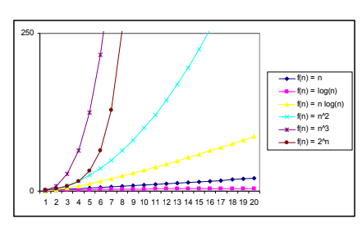
Practical Complexity

Slide 127
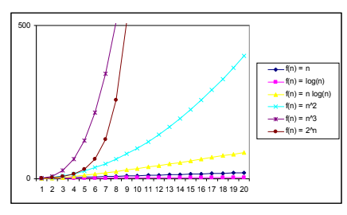
Practical Complexity

Slide 128
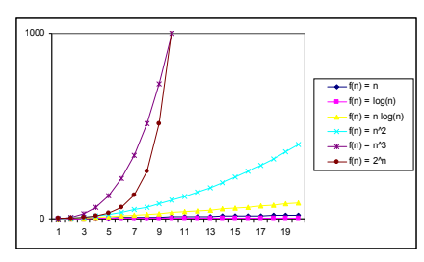
Practical Complexity

Slide 129
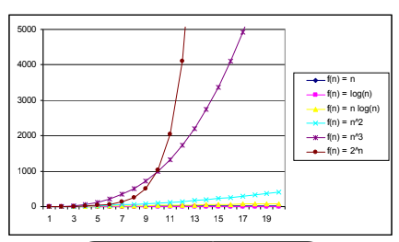
Practical Complexity

Slide 130
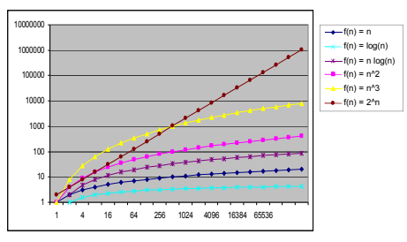
Practical Complexity

Slide 131
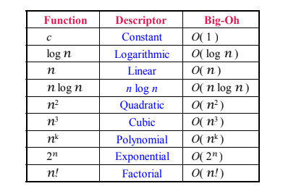
Practical Complexity

Slide 132
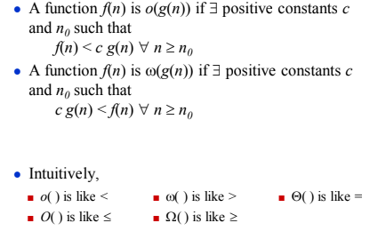
Other Asymptotic Notations and Intuitions

Slide 133
What does the best case and the worst case imply?
T(n) = an² + bn + c
Time
T(n) = an + b
Number of elements n

Slide 134
NEXT CLASS
A bit more about asymptotic notations and more on other algorithms

Slide 135
Thank You

